Slide 1
Wildfire Burn Area Modeling in Colorado Using Multi-Layer Perceptron Classification
Brenner Burkholder, Mina Wei

Slide 2
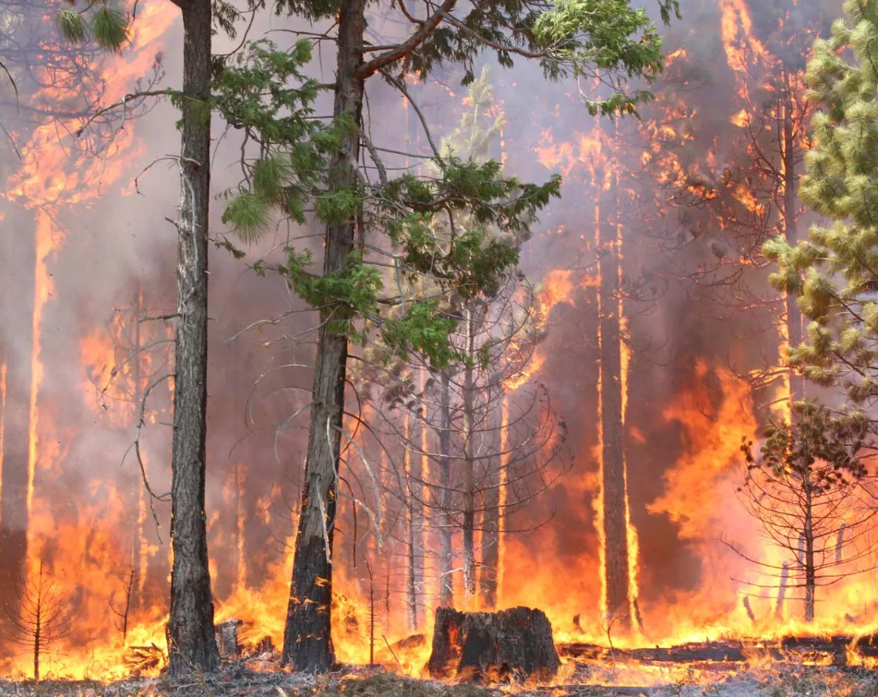
Introduction
The frequency of wildfires in the western United States is increasing due to climate change (Oliveira & Sá, 2021)
Wildfires are a natural occurrence that can be nearly impossible to stop and challenging to control, and frequent forest wildfires have devastated the planet
Our study aims to collect and analyze variables related to wildfire risk, and use neural network multi-layer-perceptron to predict burn area
Notes:
Wildfires are a natural occurrence that can be nearly impossible to stop and challenging to control.
Frequent forest wildfires have devastated the planet: releasing years of carbon stored in the land, and causing a significant loss of carbon absorption capacity in future trees, forest soil erosion, and increased air pollution from toxic particulates.
Therefore, we plan to collect and analyze variables related to wildfire risk that are found in the literature and in applied models from organizations. Once we have collected the core variables of wildfire risk, we will create a categorical risk index; ideally, we will have enough time to test different models and variables against the burned-unburned binary image using TerrSet's multi-layer perceptron tool.

Slide 3
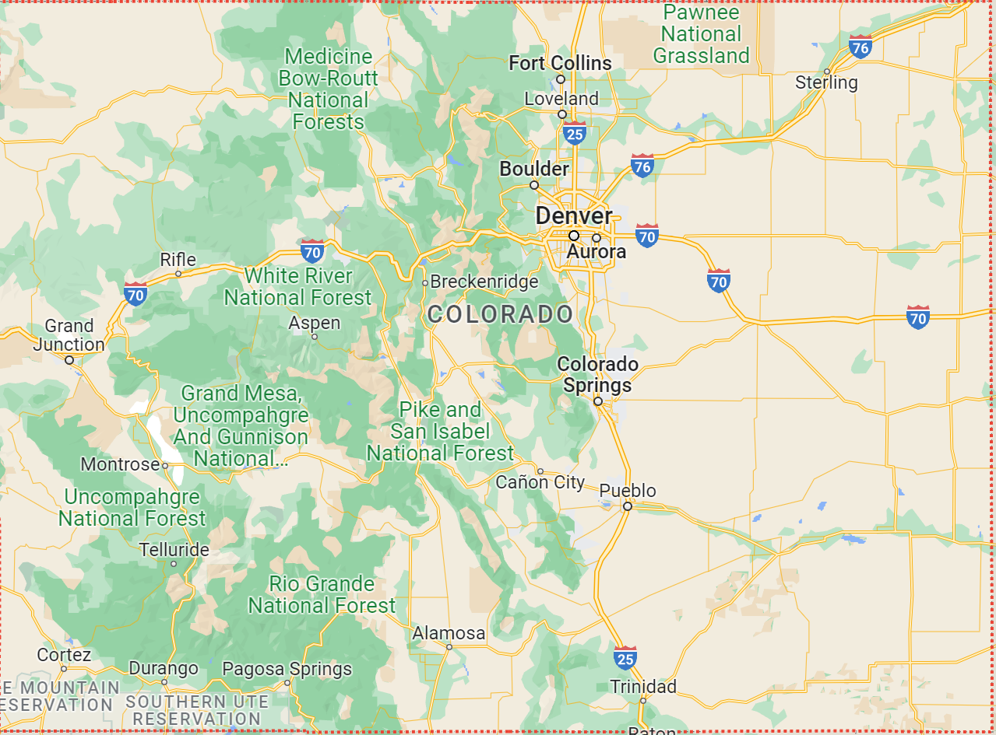
Study Area
This study is looking at the state of Colorado
Colorado has the highest peak in the Rocky Mountains
Colorado is severely impacted by climate change as temperatures rise and available water resources diminish
Notes:
Highlands in the northeast and large plains in the west
Colorado is known for its vivid landscapes of mountains, forests, plateaus, tablelands, canyons, plateaus, rivers and deserts
Climate has a big impact on Colorado
Colorado is rich in forest resources

Slide 4
Method Outline
Data Acquisition
Processing
Multi-Layer Perceptron
Results
Aspect and Slope in GEE
Clip to CO Border and Import into TerrSet (All)
Aspect and Slope Surfaces
2015 Classified Image
LANDFIRE Existing Vegetation Types
Summarize Classes and Create Evidence Likelihoods
EVT Evidence Likelihood Surface
2021 Classified Image
USGS Watershed Boundary HU 12 Dataset
Summarize Pre-Study Year Fire Area in Watersheds
Fire Density by Watershed, Pre-Fire
TOC Curve Analysis
SILVIS Lab Wildland-Urban Interface 2010
Calculate Distance Surfaces
WUI Intermix and Interface Distance Surfaces
ISU Historic Fires Database 1950-2021
Create Boolean Images for 2015 and 2021 Study Years
2015 and 2021 Boolean Fire Image for Testing / Training
Notes:
2015: 21.57” statewide precip average https://www.ncei.noaa.gov/access/monitoring/climate-at-a-glance/statewide/rankings/5/pcp/201511
2021: 16.2” statewide precip average

Slide 5
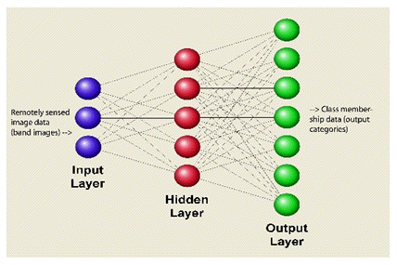
Multi-Layer Perceptron Classification
Empirical method using back-propagation- category of Artificial Neural Networks with many use cases including fire susceptibility (Jain et al. 2020)
Source: TerrSet Help System

Slide 6
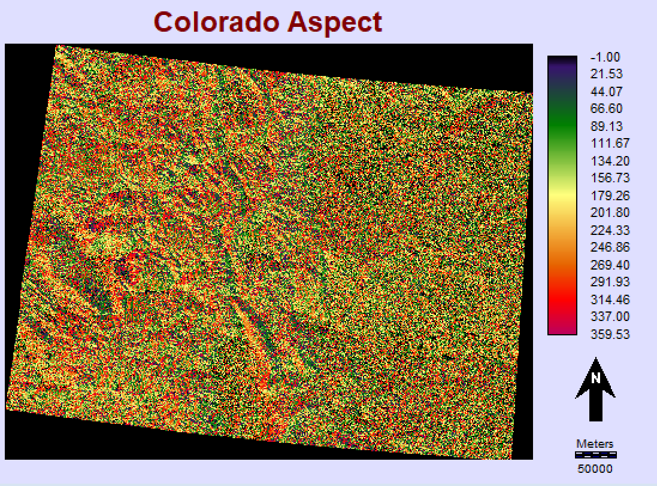
Aspect
Direction slope is facing
Southern aspects dry due to sun exposure, greater risk of ignition
Consistently low influence during MLP exploration, removed from final models

Slide 7
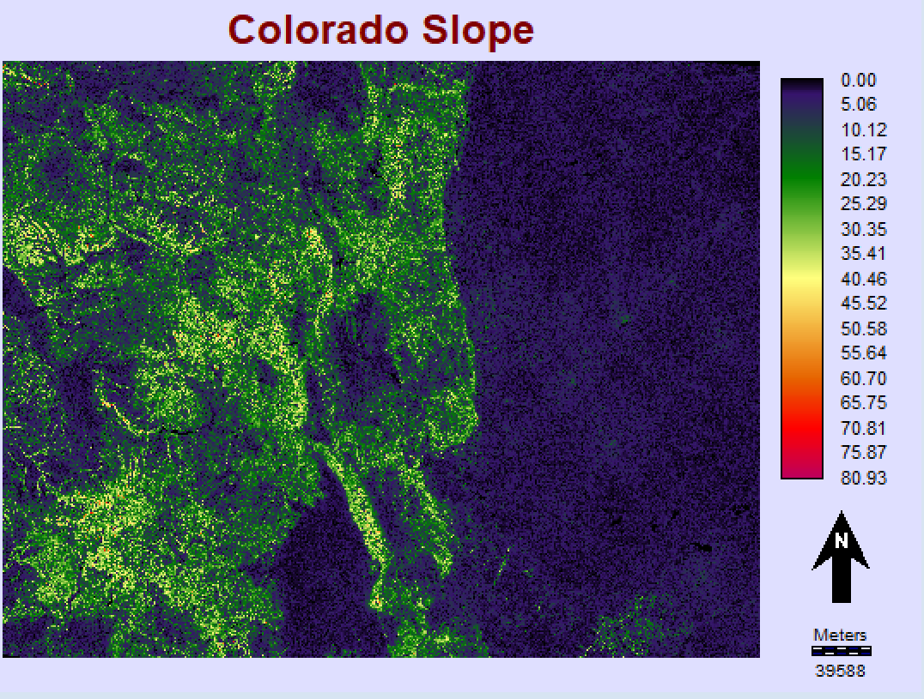
Slope
The northwestern part of Colorado is a highland, and the eastern part is the plains. Forests are concentrated in the western mountains
The high slope is in the Rocky Mountains

Slide 8
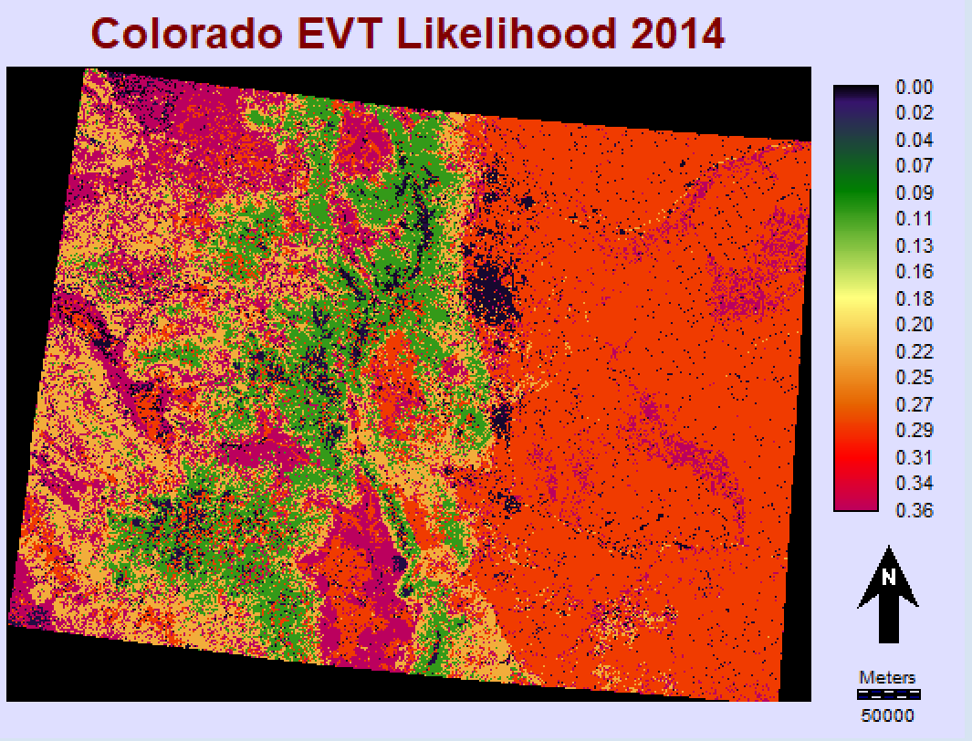
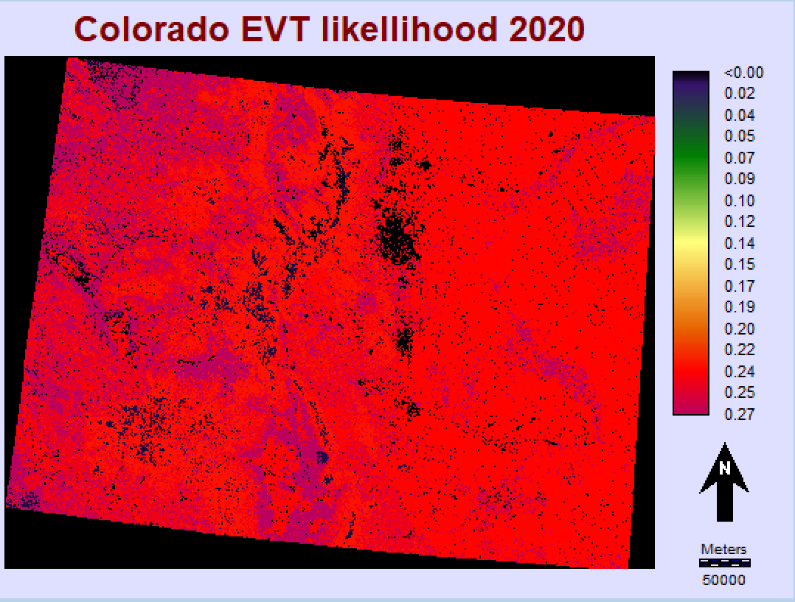
Existing Vegetation Type
Evidence Likelihood images: % of vegetation class intersecting fires from 1950-2014 and 1950-2020
Image for 2015 analysis- highest was 36% shrubland touching fire areas
2020- shrubland, open canopy, grassland and closed canopy all roughly 25%
Notes:
Existing vegetation types (EVT) represent the current distribution of terrestrial ecosystem classifications

Slide 9
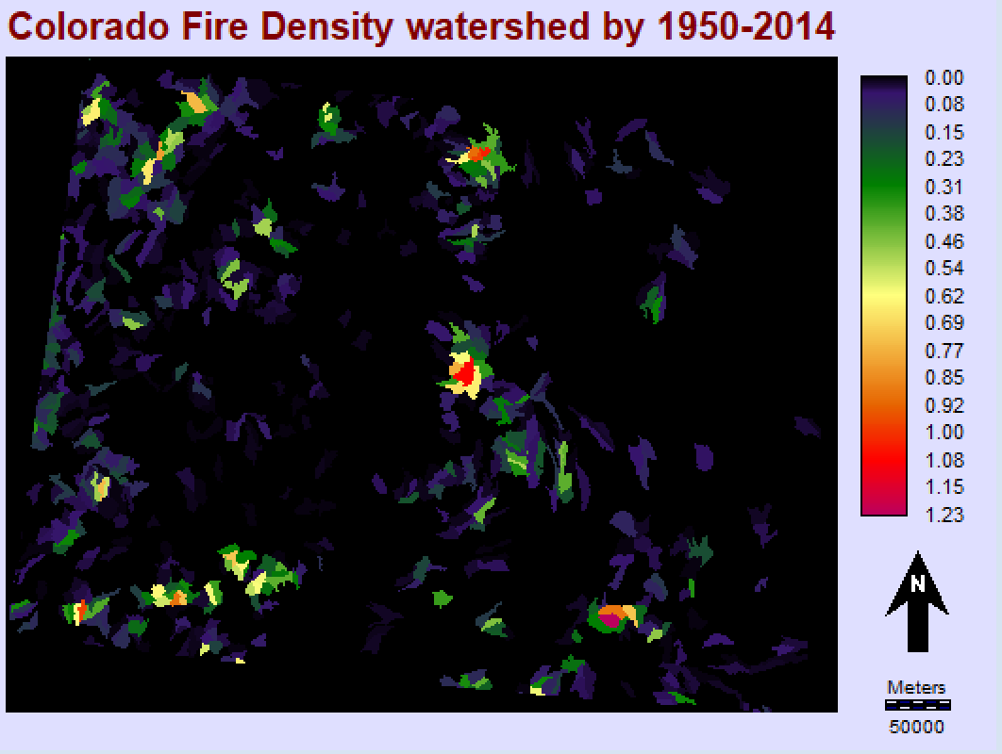
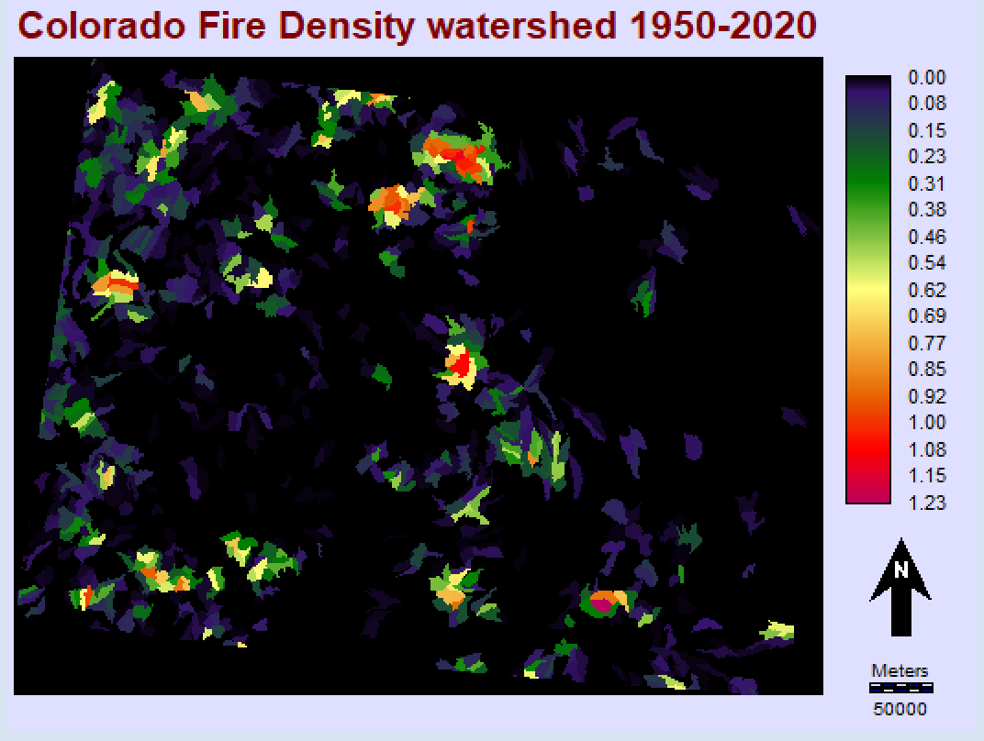
Fire Density Watershed
Historic fire in Colorado from 1950-2014 and 1950-2020
Total fire area within the watershed divided by the total area of the watershed
Fire density greater than 1 indicates multiple local burns
Notes:
Fire densities are greater than 1 due to the burn areas being summed over a 70 year time period
the year after 14 had lot more fire

Slide 10
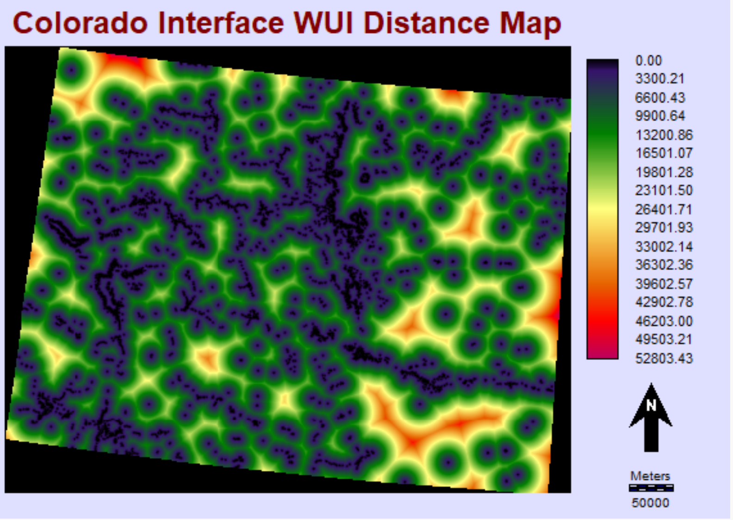
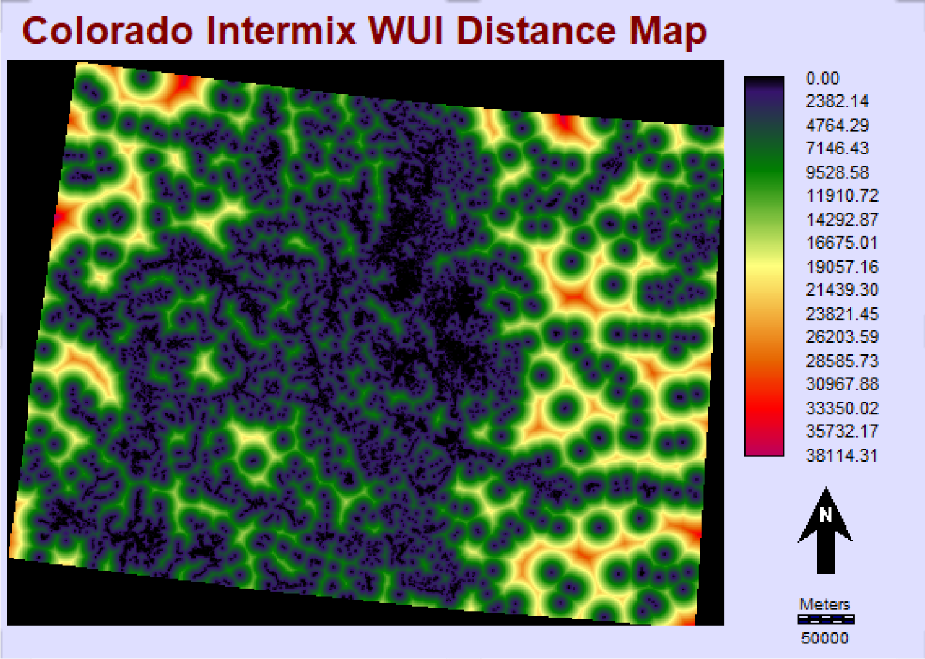
WUI Distance Map
Wildland-urban interface rapidly growing, raises fire risk (Radeloff et al. 2018)
Interface: Dense housing, <50% vegetation within 1.5 miles of wildland area
Intermix WUI
Urban and vegetation intermingle
Urban density of >1 per 40 acres
Greater than 50% of area in wildland vegetation
Notes:
interface is the housing near the area and the intermix is the housing in the area

Slide 11
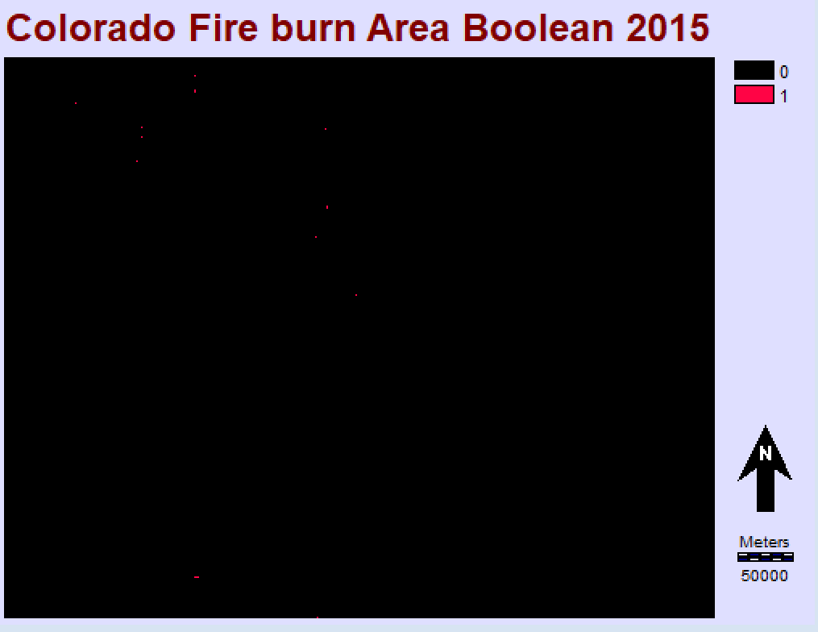
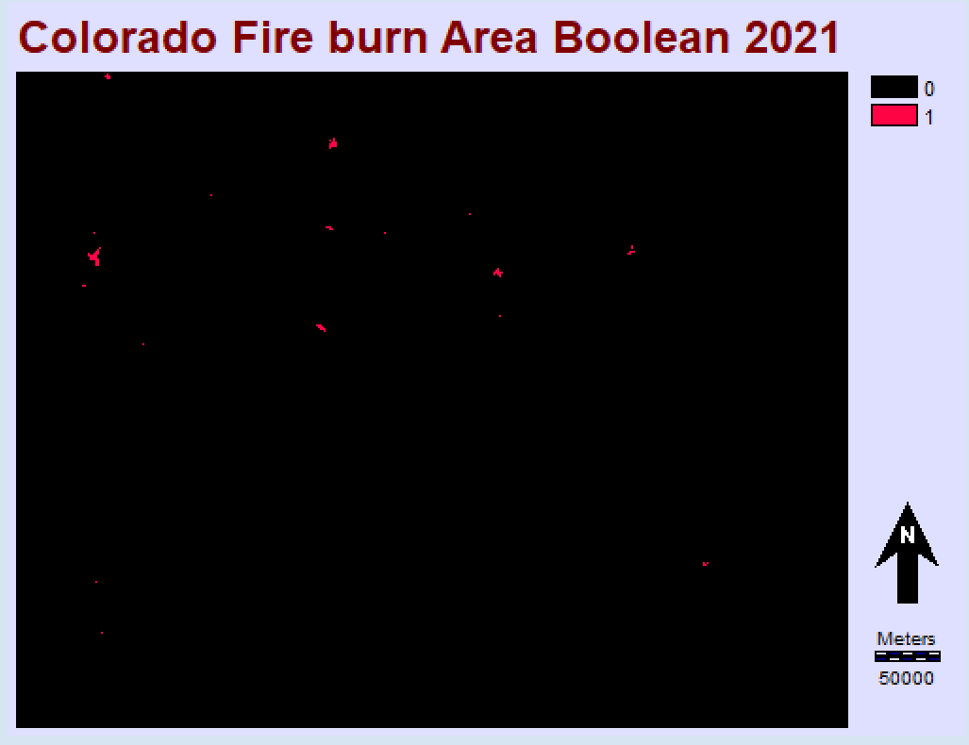
Fire Burn Area Boolean
Used to test and train MLP models for each respective year
Much larger burn area in 2021 than 2015

Slide 12
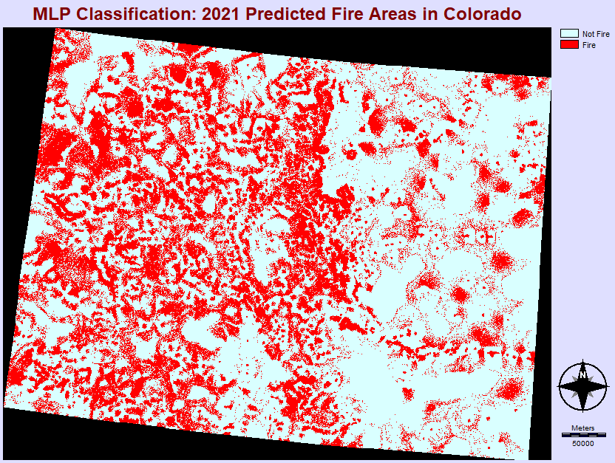
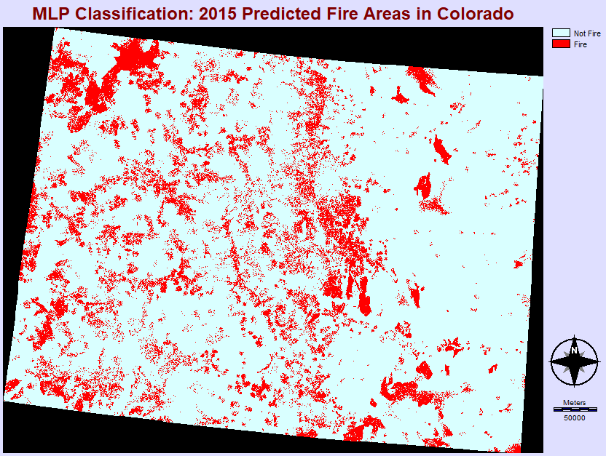
Results: MLP Classification
Notes:
Predicted burn area was much larger in 2021 than 2015- to be expected with more burn pixels, but also because EVT and Fire Density layers were made with significantly larger fire areas that occurred between 2015 and 2021

Slide 13
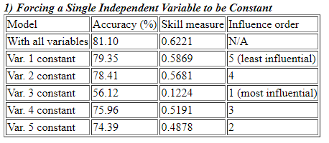
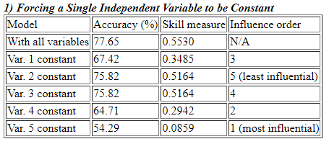
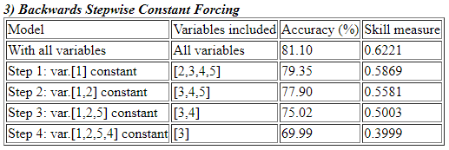
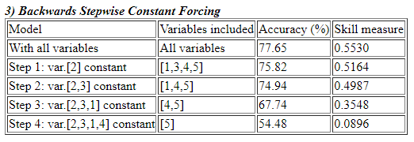
Results: MLP Performance
2015
2021
Slope
EVT
Fire Density
WUI Interface
WUI Intermix
Slope
EVT
Fire Density
WUI Interface
WUI Intermix

Slide 14
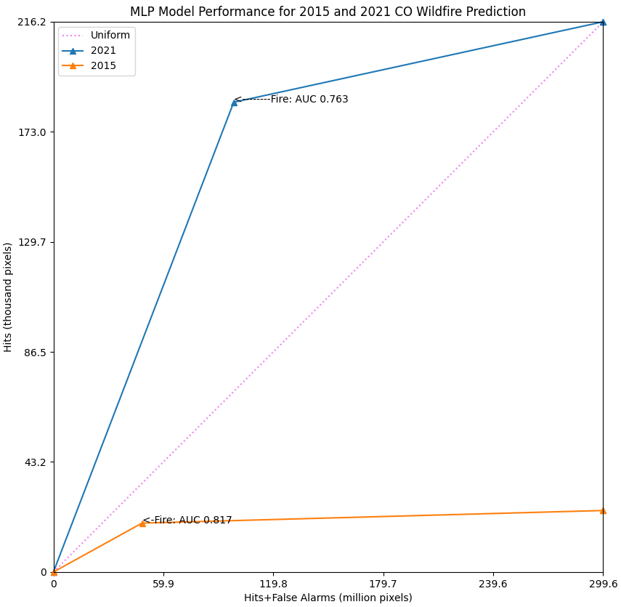
Results: MLP Performance
81% and 77% accuracy rate for 2015 and 2021 models respectively
2021 performed much worse most of the time
Misleading TOC- 2021 hit intensity much higher because more burned area = more hits
Better to overpredict- high false alarm rate

Slide 15
Discussion and Conclusion
Drivers: Watershed Fire Density consistently most influential for 2015; WUI followed by Slope in 2021; EVT Evidence Likelihood consistently low or lowest both years for most model runs
EVT methodology flawed: should have used additive area like Fire Density, using total area covered causes shift when new vegetation types burn
change in likelihood allocation suggests changing fire regimes, veg type susceptibility
WUI driver in 2021 could suggest more human ignition, need for 2020 data because WUI likely expanded since 2010
Further study should incorporate non-static variables like Evaporative Stress Index, Normalized Difference Moisture Index etc

Slide 16
Thank You for Listening!

Slide 17
References
Burkholder, B., Freyberg, F., Hiatt, J., & Schuetze, C. (2022). NASA DEVELOP Idaho Wildfire Project. DEVELOP Idaho Node, Summer 2022.
Jain, P., Coogan, S. C. P., Subramanian, S. G., Crowley, M., Taylor, S., & Flannigan, M. D. (2020). A review of Machine Learning Applications in wildfire science and management. Environmental Reviews, 28(4), 478–505. https://doi.org/10.1139/er-2020-0019
Oliveira, S., Rocha, J., & Sá, A. (2021). Wildfire risk modeling. Current Opinion in Environmental Science & Health, 23. https://doi.org/10.1016/j.coesh.2021.100274
Radeloff, V. C., Helmers, D. P., Kramer, H. A., Mockrin, M. H., Alexandre, P. M., Bar-Massada, A., Butsic, V., Hawbaker, T. J., Martinuzzi, S., Syphard, A. D., & Stewart, S. I. (2018). Rapid growth of the US wildland-urban interface raises wildfire risk. Proceedings of the National Academy of Sciences, 115(13), 3314–3319. https://doi.org/10.1073/pnas.1718850115

